Slide 1

ITC 6000 Database Management SQL Murder Mystery Lab
Professor Neil Clauson
n.clauson@northeastern.edu

Slide 2
Overview
Practice SQL commands to
Retrieve data
Filter and Sort
Query multiple tables through JOINs
Investigate and analyze data
Perform labs using your lab environment.

Slide 3
SQL Murder Mystery
A crime has taken place and the detective needs your help.
The detective gave you the crime scene report, but you somehow lost it.
You vaguely remember that the crime was a ​murder​ that occurred sometime on ​Jan.15, 2018​ and that it took place in ​SQL City​.
Start by retrieving the corresponding crime scene report from the police department’s database.

Slide 4
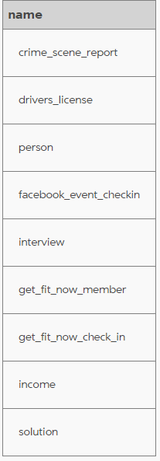

Step 1 – Get familiar with the data (1)
Use the master schema to understand all of the tables within the database
Exact syntax depends on the type of database server

Slide 5
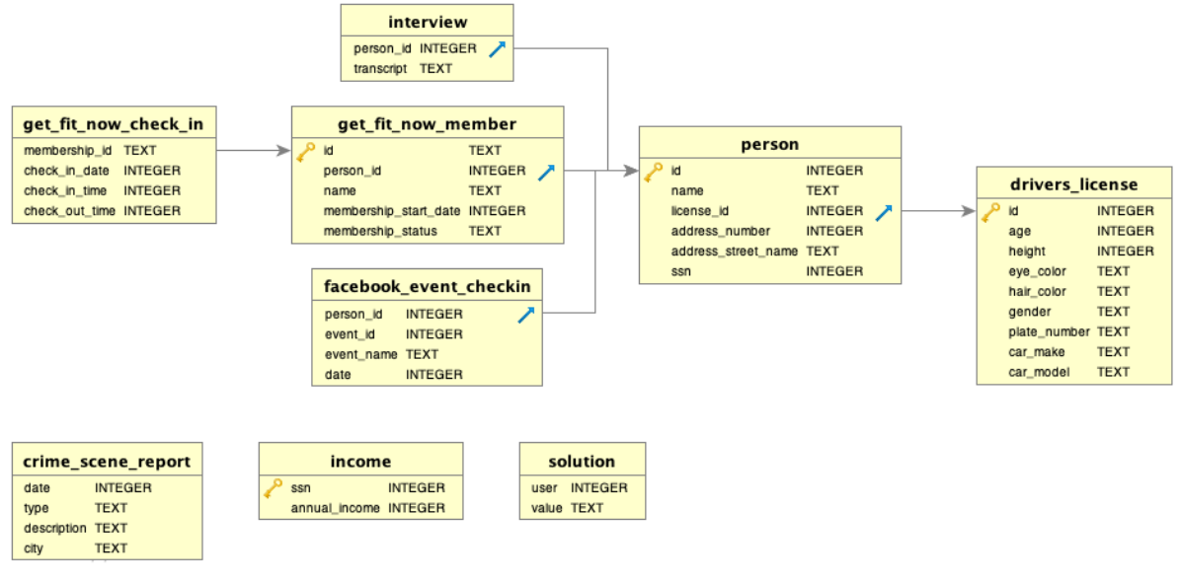
ERD Diagram
Notes: This database is design for learning purposes, and is not fully optimized (1NF, 2NF, etc)

Slide 6
Step 1 – Get familiar with the data (2)
Use table definitions to understand data types and relationships

Slide 7
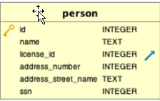






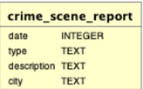

Step 1 – Get familiar with the data (3)
Understand the quantity of data
Answers “how many rows per table”

Slide 8

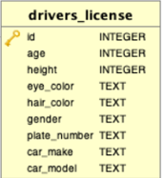


Aggregation

Slide 9
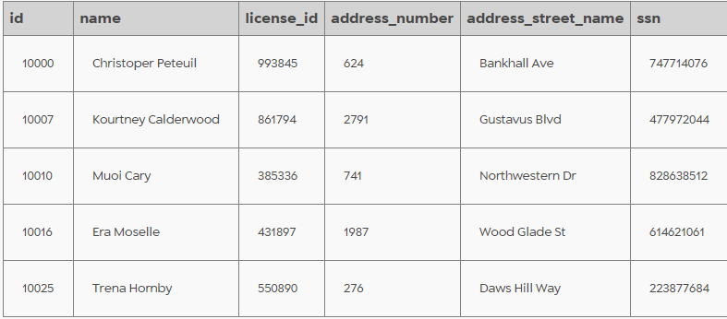
Step 1 – Get familiar with the data (3)
Explore samples of the data:
* = wildcard. Selects all fields
LIMIT = total number of rows returned

Slide 10
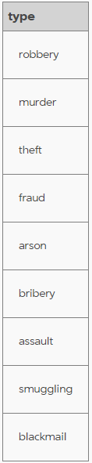
Step 1 – Get Familiar with the Data (4)
Understand the range of possible values within your dataset

Slide 11
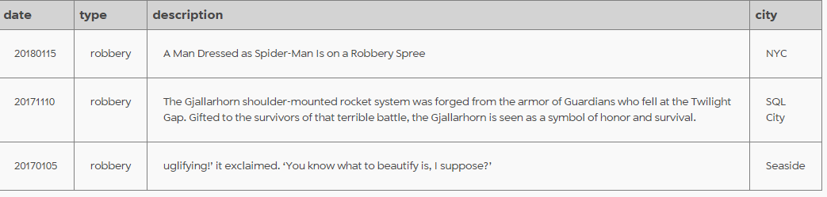
Filter Results to Specific Criteria
SQL WHERE clause

Slide 12







Complex WHERE clauses

Slide 13
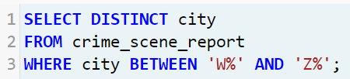
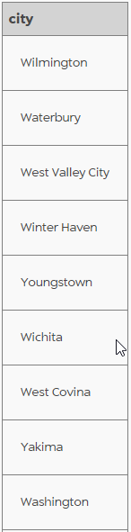
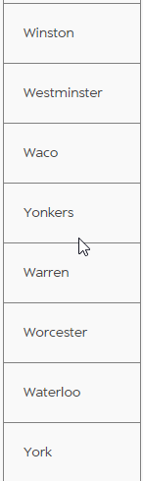
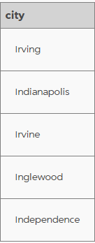

Other Comparisons

Slide 14
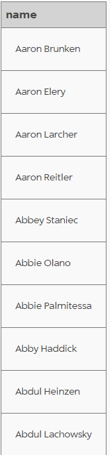

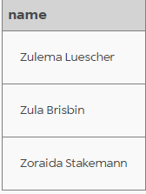
Order By

Slide 15
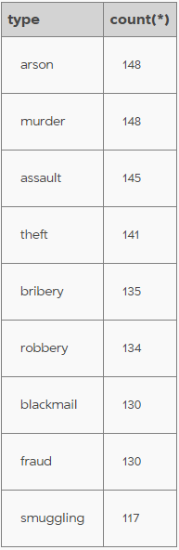
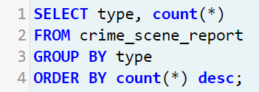
Aggregating with Group By

Slide 16
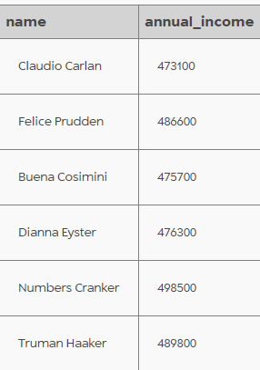
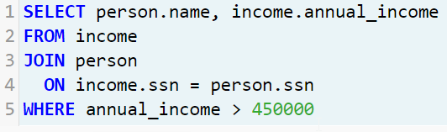
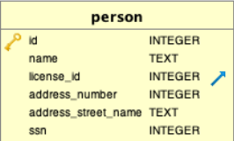

JOINs

Slide 17
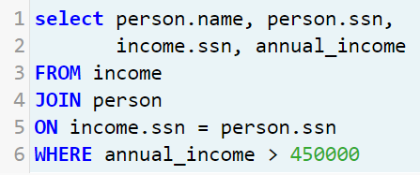
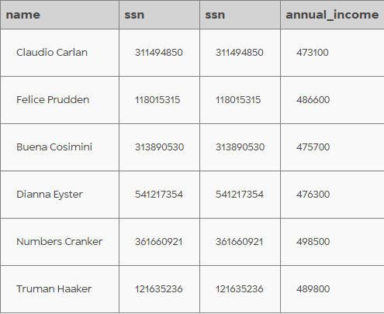
Why does this work?
Because the two tables share a common field (in this case, ‘ssn’)
Shouldn’t matter which is FROM and which is JOIN
Can be combined with all of the previous SQL syntax
Can join multiple tables

Slide 18
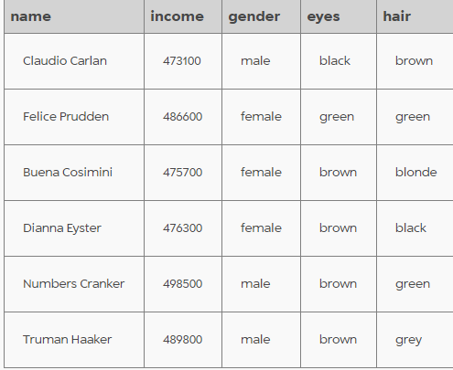
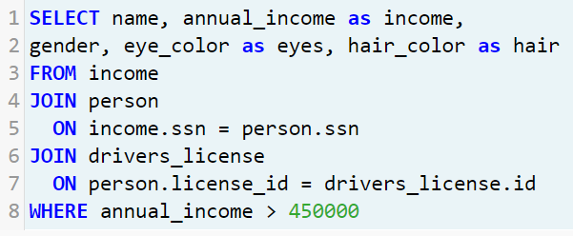
JOINs with 2+ tables
Just keep adding JOIN <table name> ON <matching fields>
Test iteratively!

Slide 19
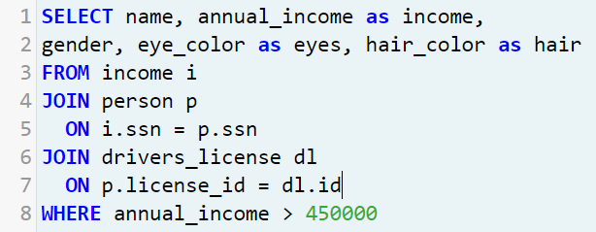
Aliases
Lets you more easily refer to columns in a long query.
A column is given an alias for the query (annual_income as income)
A table is given an alias (person as ‘p’)

Slide 20
Let’s Solve the Murder
Review the facts
Ask the right questions
Solve the puzzle

Slide 21
ERD Diagram
Notes: This database is design for learning purposes, and is not fully optimized (1NF, 2NF, etc)

Slide 22
SQL Murder Mystery
A crime has taken place and the detective needs your help.
The detective gave you the crime scene report, but you somehow lost it.
You vaguely remember that the crime was a ​murder​ that occurred sometime on ​Jan.15, 2018​ and that it took place in ​SQL City​.
Start by retrieving the corresponding crime scene report from the police department’s database.

Slide 23
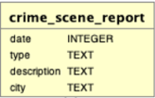
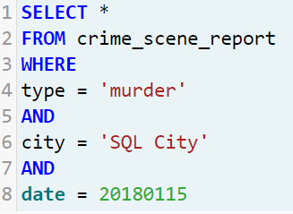
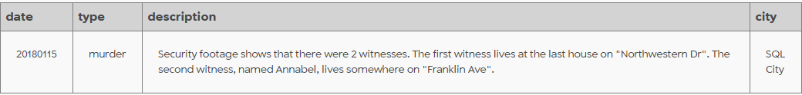
Start the investigation
crime_scene_report
Type = murder
Date = 01/15/2018
City = SQL City

Slide 24
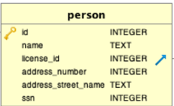
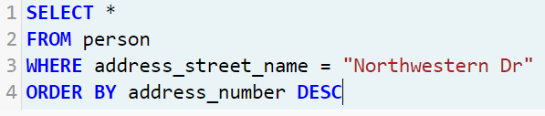

Witness #1
Note how the DESC modifier returns the results in reverse, or descending, order

Slide 25
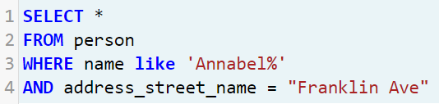
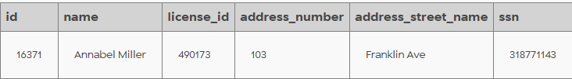
Witness #2

Slide 26


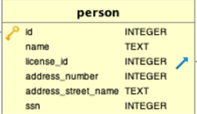
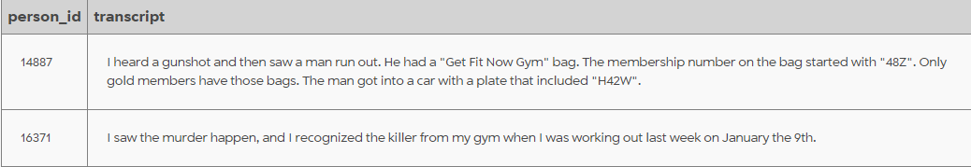
Access the Witness Statements

Slide 27
Clues
It was a man
He had a gym bag
Gym Membership ID began with ‘48Z’
Only Gold Members have that type of bag
License plate of getaway car includes ‘H42W’
Murder date was 2018-01-09

Slide 28
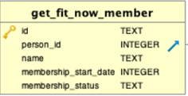
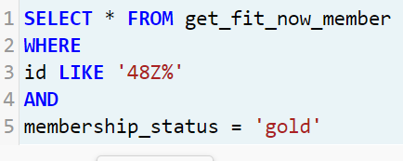
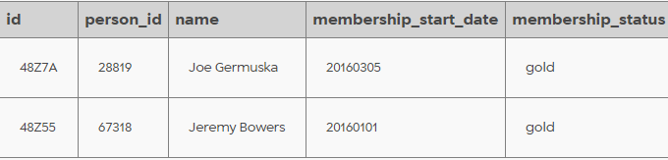
Select with compound Where clause

Slide 29
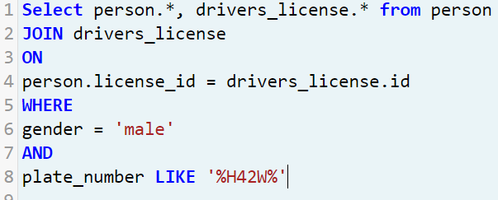
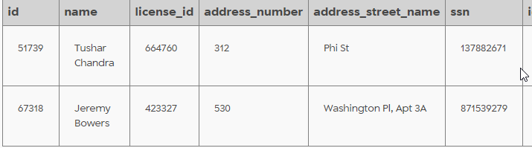
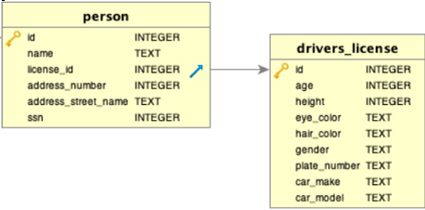
Select with Join

